Slide 1
Exception Handling

Slide 2
Agenda
Introduction
Catching exceptions
Multiple catch blocks
Nested try statements
throw
throws
finally
Built-in exceptions
User defined exceptions
Chained exceptions

Slide 3
What is Exception?
An exception is an abnormal condition that arises in a code sequence at runtime.
A Java exception is an object that describes an exceptional (that is, error) condition that had occurred in a piece of code.
When an exceptional condition arises, an object representing that exception is created and thrown in the method that caused that error. That method may choose to handle the exception itself, or pass it on. Either way, at some point, the exception is caught and processed.
Java exception handling is managed via five keywords:
try
catch
throw
throws
finally

Slide 4
What is Exception?
Program statements that you want to monitor for exceptions are contained within a try block.
If an exception occurs within the try block, it is thrown, your code can catch this exception (using catch) and handle it in some rational manner.
To manually throw an exception, use the keyword throw.
Any exception that is thrown out of a method must be specified as such by a throws clause.
Any code that absolutely must be executed after a try block completes is put in a finally block.
If the programmer does not catch the exception, it is thrown automatically to the caller function.
If an exception is thrown from the main function, the program is terminated abnormally.

Slide 5
Exception
Here, ExceptionType is the type of exception that has occurred.

Slide 6

Uncaught Exceptions
What happens when we don’t handle exceptions:
When the Java run-time system detects the attempt to divide by zero, it constructs a new exception object and then throws this exception.
Since no exception handlers were provided, so the exception is caught by the default handler provided by the Java run-time system.
The default handler displays a string describing the exception, prints a stack trace from the point at which the exception occurred, and terminates the program.

Slide 7
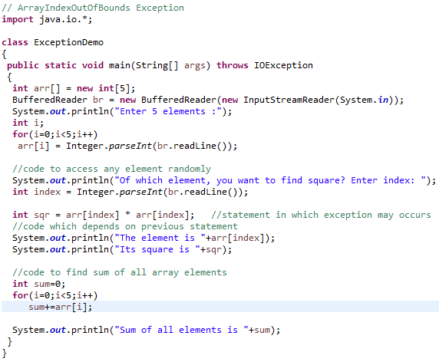
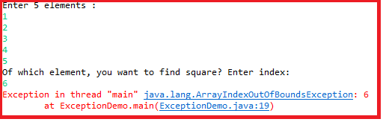
Uncaught Exceptions

Slide 8
Exception Propagation
Exceptions are always propagated from the called method to the caller method, if thrown from the called method
If an Exception is thrown from the main() method, it will be propagated to the Java Runtime
In exception propagation, all statement executions are ignored until finding the exception handler

Slide 9
Exception Propagation (Contd…)
public class Propagate {
void calculate() {
int m = 25, i = 0;
i = m / i;
}
public static void main(String[] args) {
Propagate p = new Propagate();
p.calculate();
}
}
ArithmeticException Occurred
Exception propagated from main( )
function to java
Exception propagated from calculate() to
main() method
Exception in thread "main" java.lang.ArithmeticException: / by zero
at Propagate.calculate(Propagate.java:4)
at Propagate.main(Propagate.java:8)

Slide 10
Catching Exceptions
A try statement executes a block and oversees the execution of enclosed statements for exceptions
try also defines the scope for exception handlers (defined in catch clause)
A try block must be accompanied by at least one catch block or one finally block
Any method declared as being able to throw an Exception, can have a try / catch block to handle the exception

Slide 11
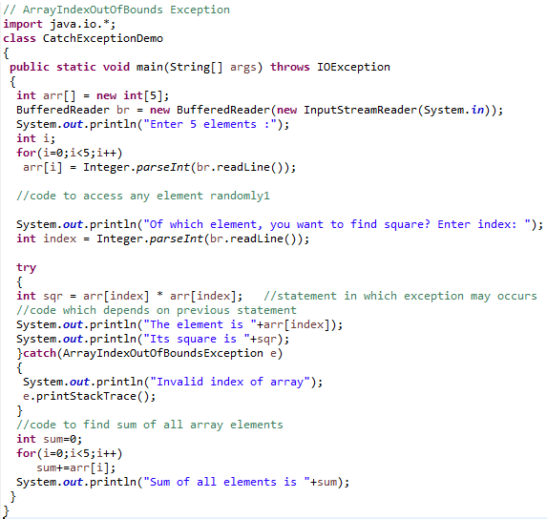
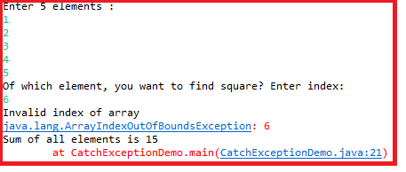
Catching Exceptions

Slide 12
Multiple catch blocks
In some cases, more than one exception could be raised by a single piece of code
When an exception is thrown, each catch statement is inspected in order, and the first one whose type matches that of the exception is executed.
After one catch statement executes, the others are bypassed, and execution continues after the try/catch block.

Slide 13
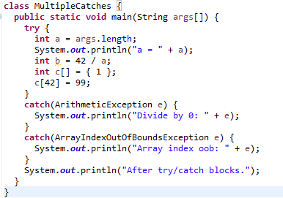

Multiple catch blocks

Slide 14
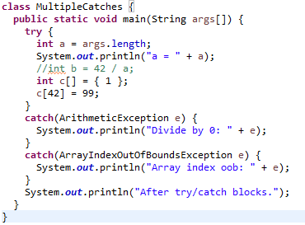

Multiple catch blocks

Slide 15
Multiple catch blocks
When you use multiple catch statements, it is important to remember that exception subclasses must come before any of their super classes. This is because a catch statement that uses a superclass will catch exceptions of that type plus any of its subclasses.
Thus, a subclass would never be reached if it came after its superclass.
Further, in Java, unreachable code is an error.

Slide 16
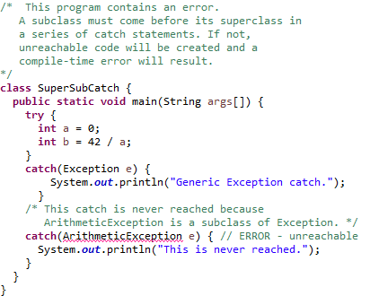

Multiple catch blocks

Slide 17
Nested try statements
That is, a try statement can be inside the block of another try. Each time a try statement is entered, the context of that exception is pushed on the stack.
If an inner try statement does not have a catch handler for a particular exception, the stack is unwound and the next try statement’s catch handlers are inspected for a match.
If no catch statement matches, then the Java run-time system will handle the exception.

Slide 18
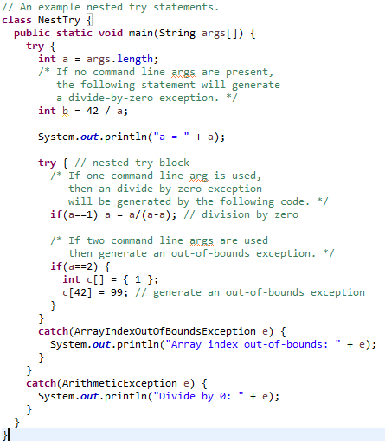
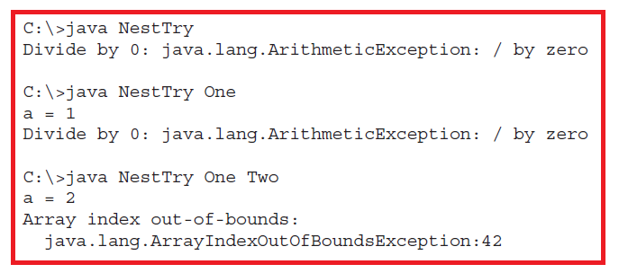
Nested try statements

Slide 19
Nested try statements
You can enclose a call to a method within a try block. Inside that method is another try statement.
In this case, the try within the method is still nested inside the outer try block, which calls the method.

Slide 20
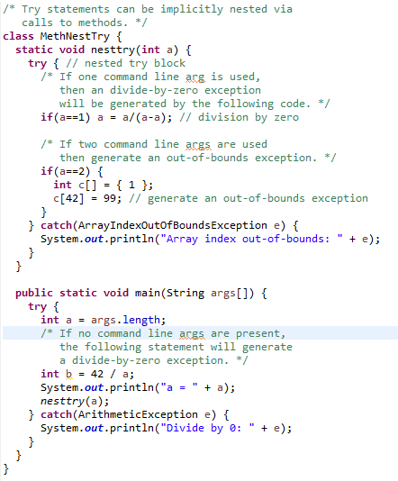
Nested try statements

Slide 21
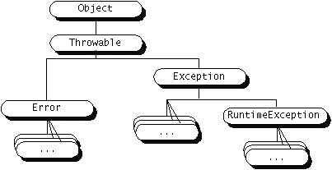
Exception Hierarchy

Slide 22
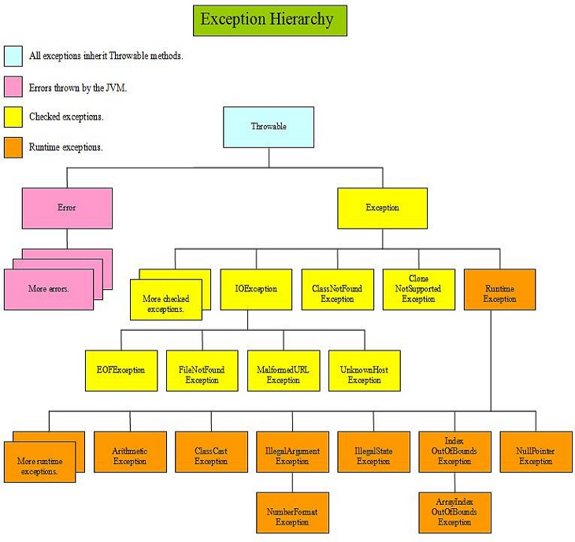
Exception Hierarchy

Slide 23
Categories of Exceptions
Java exceptions fall in two categories:
Unchecked
Not checked by the compiler at compile time
Does not force the client program / method to declare each exception thrown by a method, or even handle it
All exceptions are derived from RuntimeException class
Checked
Checked by the compiler to see if these exceptions are properly caught or specified, & if not, the code fails to compile
Forces client program to deal with the scenario in which an exception may be thrown
All exceptions which are not derived from RuntimeException class

Slide 24
Concept of “throw”
It is possible for the program to throw an exception explicitly, using the throw statement.
The general form of throw is shown here:
throw ThrowableInstance;
Here, ThrowableInstance must be an object of type Throwable or a subclass of Throwable.
Primitive types, such as int or char, as well as non-Throwable classes, such as String and Object, cannot be used as exceptions.
There are two ways you can obtain a Throwable object:
Using a parameter in a catch clause, or
Creating one with the new operator.

Slide 25
Concept of “throw”
The flow of execution stops immediately after the throw statement; any subsequent statements are not executed.
The nearest enclosing try block is inspected to see if it has a catch statement that matches the type of exception.
If it does find a match, control is transferred to that statement.
If not, then the next enclosing try statement is inspected and so on.
If no matching catch is found, then the default exception handler halts the program and prints the stack trace.

Slide 26
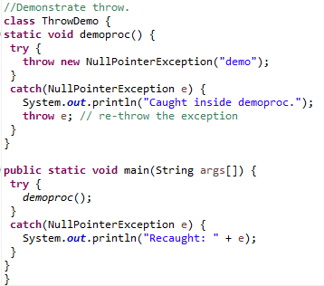

Concept of “throw”

Slide 27
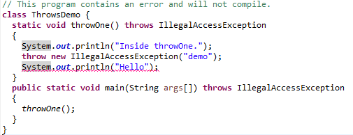
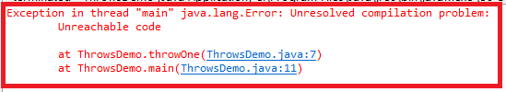
Concept of “throw”

Slide 28
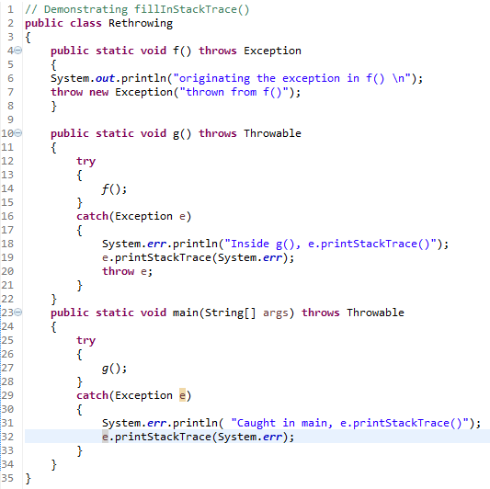
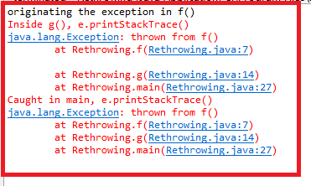
Concept of “throw”

Slide 29
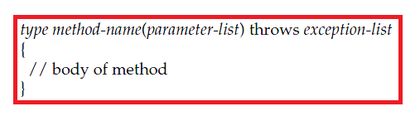
Concept of “throws”
If a method is capable of causing an exception that it does not handle, it must specify this behaviour so that callers of the method can guard themselves against that exception
It is done by including a throws clause in the method’s declaration
A throws clause lists the types of exceptions that a method might throw.
This is necessary for all exceptions, except those of type Error or RuntimeException, or any of their subclasses.
This is the general form of a method declaration that includes a throws clause:

Slide 30
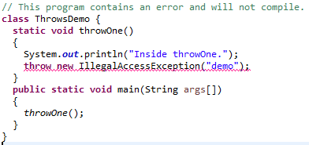
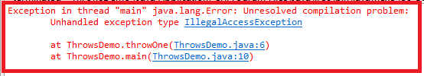
Concept of “throws”

Slide 31
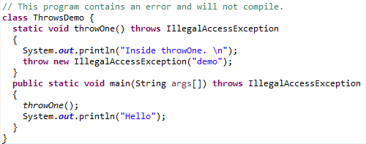

Concept of “throws”

Slide 32
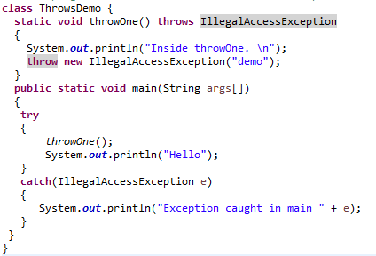

Concept of “throws”

Slide 33
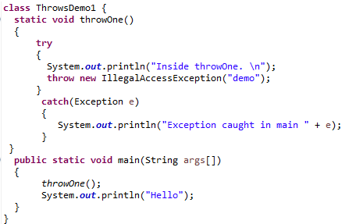

Without “throws”

Slide 34
Concept of “finally”
Sometimes, while in a try / catch block, an Exception could be thrown before some important code at the end of the try block.
The finally block can be used to run this code.
Code in finally always executes (even in case of unhandled exceptions).
The finally clause is optional.
Each try statement requires at least one catch or a finally clause.

Slide 35
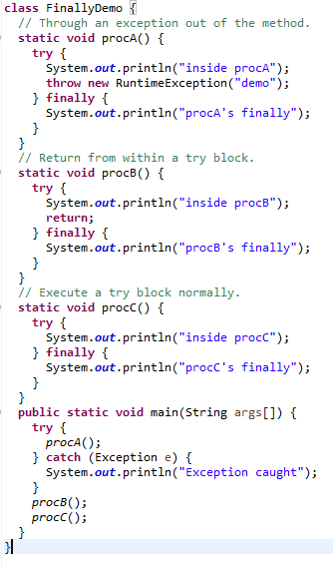
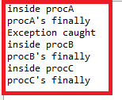
Concept of “finally”

Slide 36
Exception methods
What type of information do we get from the Exception objects:
getCause()
getMessage()
printStackTrace()
Subclasses of Exception can be much more elaborate and contain more information if desired

Slide 37
Exception methods

Slide 38
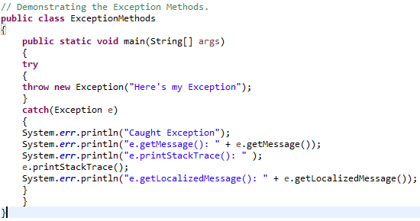
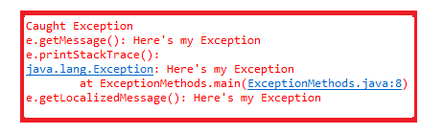
Exception methods

Slide 39
Java’s Built-in Exceptions
Inside the standard package java.lang, Java defines several exception classes.
The most general of these exceptions are subclasses of the standard type RuntimeException.
These exceptions need not be included in any method’s throws list. These are called unchecked exceptions because the compiler does not check to see if a method handles or throws these exceptions.
Those exceptions defined by java.lang that must be included in a method’s throws list if that method can generate one of these exceptions and does not handle it itself. These are called checked exceptions.

Slide 40
Java’s Built-in Exceptions

Slide 41
Java’s Built-in Exceptions

Slide 42
User Defined Exceptions
To create an exception, just define a subclass of Exception (which is, of course, a subclass of Throwable). Your subclasses don’t need to actually implement anything—it is their existence in the type system that allows you to use them as exceptions.
The Exception class does not define any methods of its own. It does, of course, inherit those methods provided by Throwable. Thus, all exceptions, including those that you create, have the methods defined by Throwable available to them.

Slide 43
User Defined Exceptions
You may also wish to override one or more of these methods in exception classes that you create.
Exception defines four constructors.
Exception() → has no description
Exception(String msg) → has description of the exception
Note: two constructors are explained in next topic (chained exceptions)
Override toString():
The version of toString() defined by Throwable (and inherited by Exception) first displays the name of the exception followed by a colon, which is then followed by your description. By overriding toString(), you can prevent the exception name and colon from being displayed. This makes for a cleaner output, which is desirable in some cases.

Slide 44
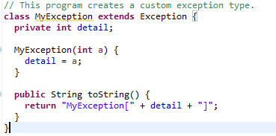

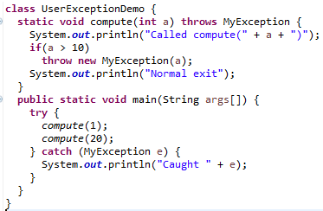
User Defined Exceptions
User Defined Exception

Slide 45
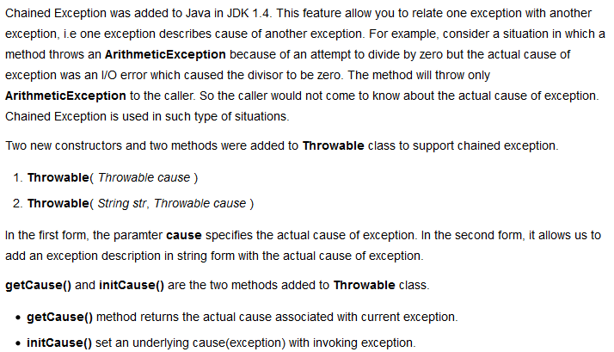
Chained Exceptions

Slide 46
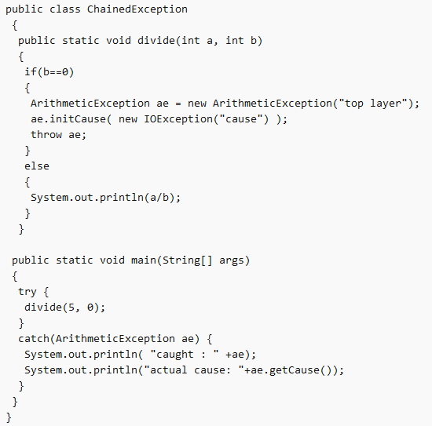

Chained Exceptions

Slide 47
THANK YOU!!
ANY QUESTIONS??

